Slide 1
Category review: Chips
June 2023
Retail Analytics
By: Nur Almar’atussaliha
Brand note: If client logo is not required, use alternate title page layout right click slide thumbnail > Layout > Title

Slide 2
Notes:
To view Privacy video explaining how important data privacy is to Quantium, please click here: https://www.youtube.com/watch?v=Zq1QDAkoRzU
or here Q:\Company Reference\Brand & Design\Brand videos\Q Privacy.mp4
At Quantium, we believe that data is the behavioural footprint of humanity and that it has to be treated with the utmost care and responsibility.
Histories, attitudes, indeed lives are stored within it in ways that aren’t always apparent – and that’s what makes its potential so powerful.
To work with it responsibly, sensitively, we set ourselves the highest data privacy protection and governance standards.
We have spent 17 years perfecting privacy-by-design and secure-by-design principles. Central to this is not holding any personally identifiable information about people –
we neither receive it, and put the necessary protections in place to be unable to decipher it.
Every aspect of handling data is safeguarded: from its de-identification, to its encryption – data security is paramount and of the highest grade.
We pride ourselves on gaining the trust of iconic organisations around the world through years of securely working with their data,
and in turn the trust that builds with their stakeholders.

Slide 3
Executive summary
01
Data Preparation and Customer Analytics
Transaction starts from 1st July 2018 to 30th June 2019 and the day where no transaction is a Christmas day where the store is closed.
The sales increase on December , a week before Christmas day the sales increases sharply.
Kettle is the most popular brand followed by Smiths, Doris, and Pringles.
Most frequent chip size purchased is 175 gr followed by 150 gr for all segments.
The older families (budget) have the highest frequency of purchased followed by young/single couples.
02
Metrics Analysis
Monthly sales increase on December and decrease on February. Monthly Sales on February is $150.665.
Monthly customer increase on December and also decrease on February.
The average monthly transaction per customer is one. It means, the customers only purchase chips once a month.

Slide 4
01
Customer Analytics

Slide 5
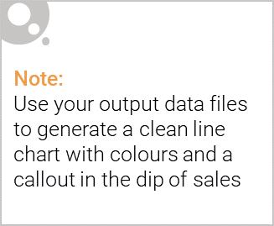
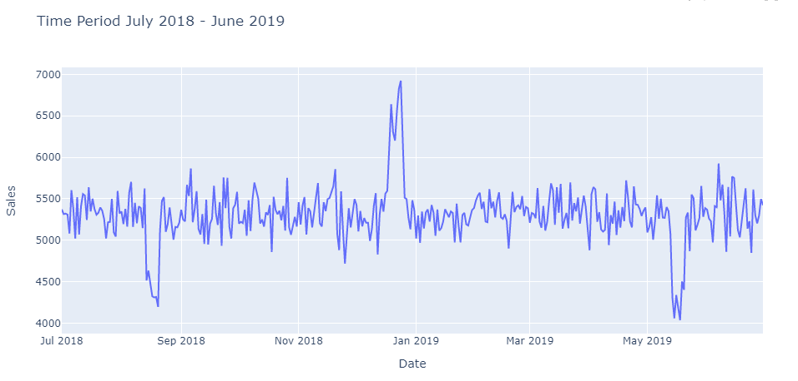
Sales Distribution
The sales decrease on August (the second week of to the third week) and also on June.
The sales increase on December (a week before Christmas day).
The chip sales is around $5000 to % $5500

Slide 6
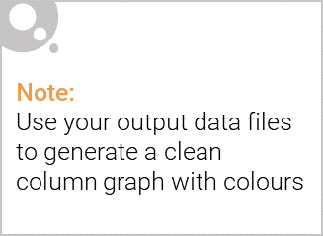
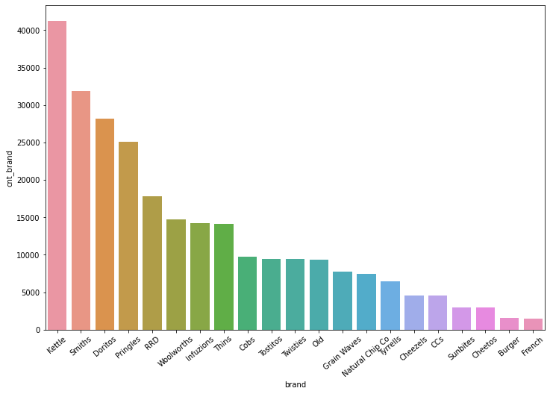
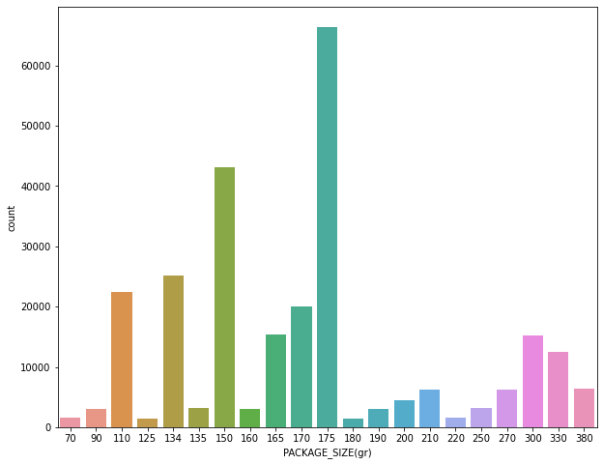
Brands and Package Sizes
Mostly customers prefer to purchase chips from kettle brand followed by Doritos and Smiths.
Mostly customers prefer to purchase chips by 175 gr package followed by 150 gr.
The packs are popular among the customers because most of the customers purchase medium size packs and many produces such packs.

Slide 7
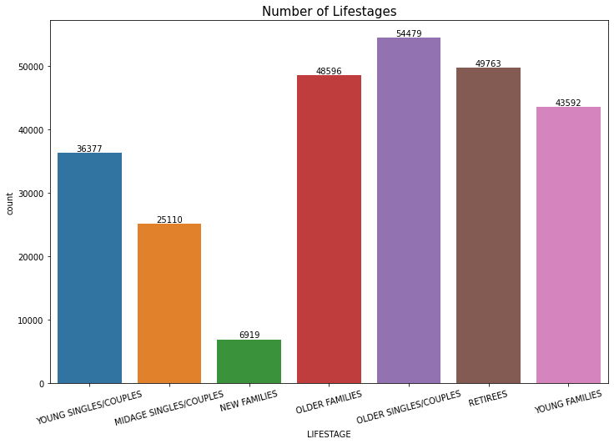
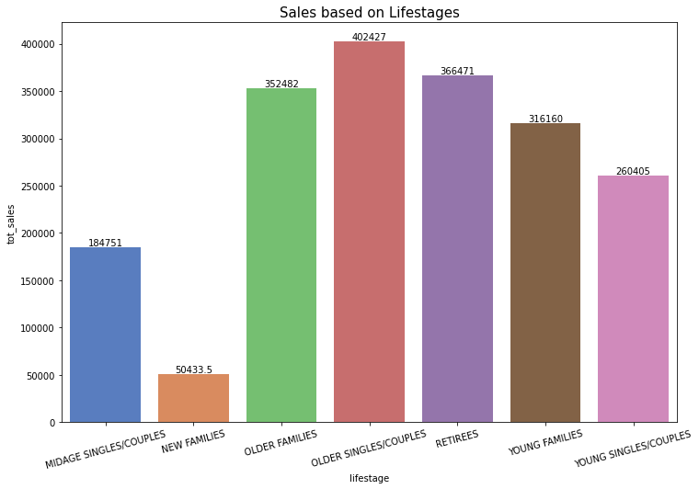
Number of Customers
Mostly customers are from older singles/couples and followed by retirees and older families.
If we see the sales by customers, the more customers you have the more you can earn.

Slide 8
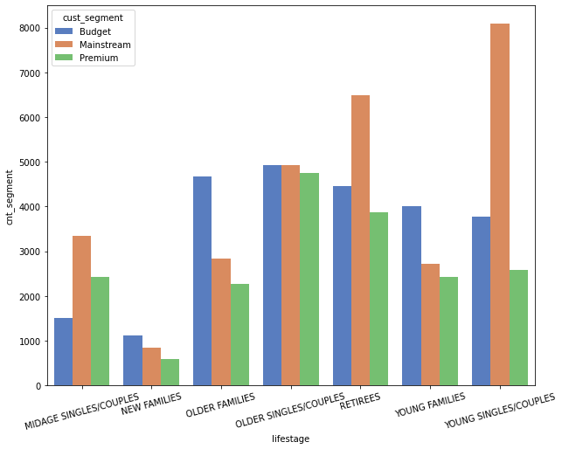
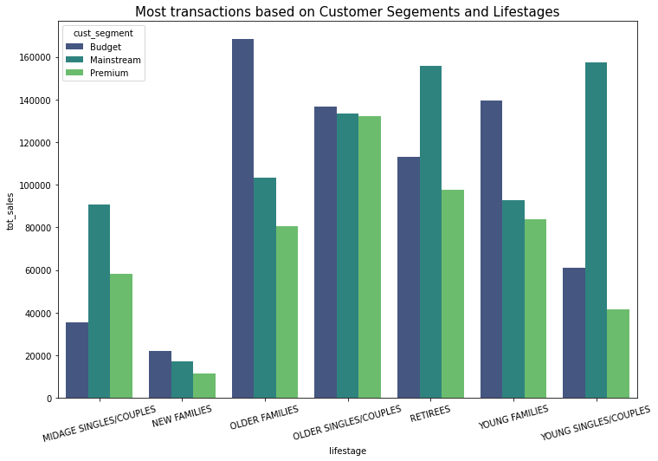
Number of Customers by Segment
Based on the segment, Mainstream – Young Singles/Couples have the highest customers followed by Mainstream - Retirees. New families in all segments have the lowest customers.
We see the transaction by segments, Budget – Older families, Mainstream – Retirees, and Mainstream – Young singles/ couples contribute to most sales.

Slide 9
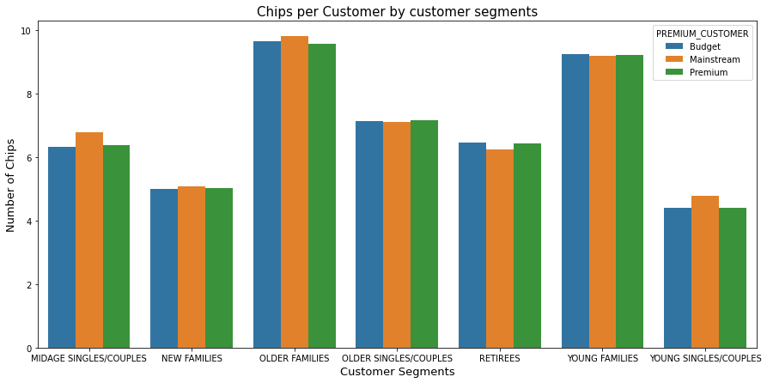
Chips per Customers
Older families for all segments purchase more chips per customers. That’s‘ why they are the largest contributions to sales.
In fact, New Families purchase more chips than Young Singles/Couples. Besides, It contributes the least to sales.
Older Families and Young Families purchase more chips per customers than any other segments because families probably have children or relatives.

Slide 10
02
Metrics Analysis

Slide 11
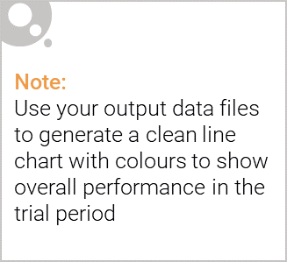
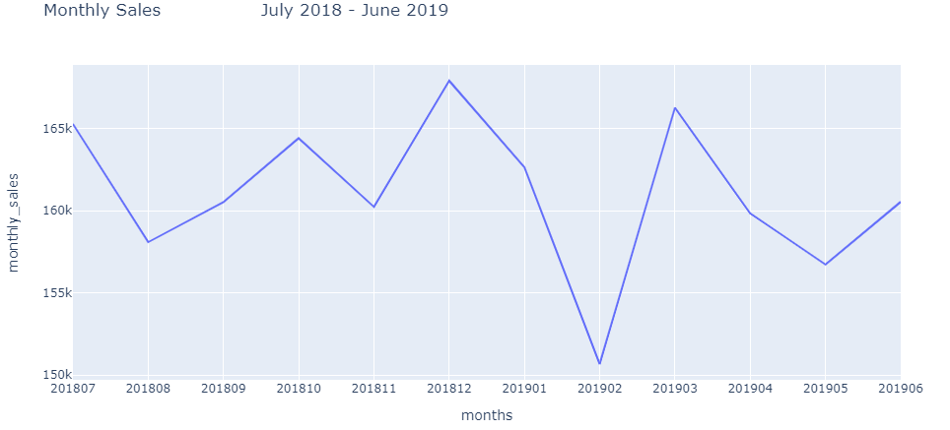
Montly Sales
The average sales of the month is $161.094.
The highest sales is on December which is $167.913 and the lowest sales is on February which is $150.665

Slide 12
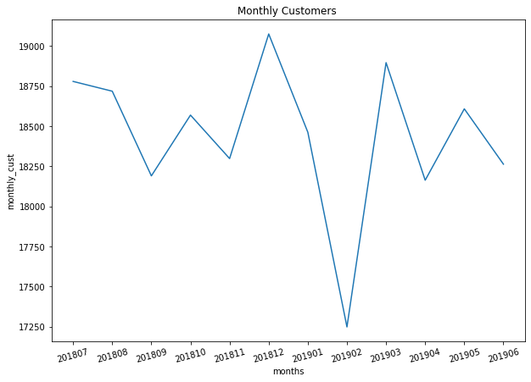
Monthly Customers
The average customer of the month is 18.440.
The highest customer is on December which is 19.076 and the lowest customer is on February which is 17.249.
If we see the trend between sales and customer , July 2018 to March 2019. If the number of customers increases, so do sales. If the customers decrease so do sales. But it is different to May 2019 – June 2019. When the number of customers increases, sales decrease.

Slide 13
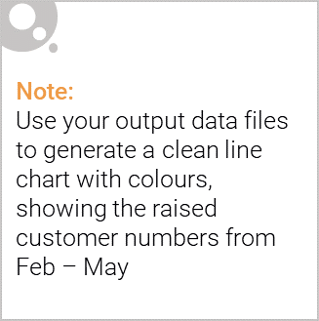
Recommendations:
The stocks must be high on December before the Chirstmas day.
Kettle, Smiths, Doritos, and Pringles must be kept in stocks as they are the most sold out.
Budget – Older Family, Mainstream – Retirees, and Mainstream – Young Singles/Couples need to get noticed as they help drive high sales.
Based on customers by segments, offer different promotions. For example: Older families spend $50 will save $10.
Multi-buys promotions to new families (i.e. buy 2 get 1 chip – 70 gr )

